Slide 1

Divine Foods Cookie Sales

Slide 2
Introduction
Divine Foods is a company that distributes a variety of cookies to buyers.
Data provided spans 5 months starting October 2023 and ending February 2024.
Divine Foods would like to better understand the sales figures, products, and customers so they can improve their processes and sales.
Notes:
Through my analysis I hope to help Divine Foods enhance its competitive edge, drive sales growth, and achieve its objectives of improving processes and profitability.
five companies order the cookies in large quantities for resale.

Slide 3
Relevant Theories, Concepts, and Methodologies:
Data Cleaning and Manipulation
Exploratory Data Analysis (EDA)
Statistical Analysis
Forecasting
Power BI Dashboard
Background and Context
Notes:
Data Cleaning and Manipulation: This involved various techniques such as filling missing values, eliminating irrelevant columns, correcting date formats, removing duplicates, and formatting data for clarity and consistency.
Exploratory Data Analysis (EDA): EDA techniques were employed to understand the structure of the data, detect anomalies, and identify initial trends or patterns. This included using PivotTables, charts, and graphs to visualize key data points.
Statistical Analysis: Statistical methods were used to analyze relationships between variables, such as conducting hypothesis testing to explore the relationship between cookie sales and the month they were sold in.
Forecasting: Forecasting techniques, such as using Excel's Forecast Sheet, were utilized to predict future profits based on sales data.
Power BI Dashboard: Power BI was used to create interactive visualizations.

Slide 4
Issues Found in the Data:
Missing Data
Data Quality Issues
Limited Data for Forecasting
Notes:
Missing Data: There were missing values in specific cells, which were filled in using appropriate methods such as filtering and correction.
Data Quality Issues: Inaccurate or inconsistent data formats, duplicate entries, and irrelevant columns were addressed to ensure data quality and reliability.
Limited Data for Forecasting: The dataset only covered 5 months, with 2 months having incomplete data, leading to challenges in forecasting and identifying long-term trends accurately.

Slide 5
Ensuring Compliance with Data Regulations:
Anonymisation
Data Security
Legal Review
Notes:
Anonymisation: Personal details such as names, phone numbers, and addresses were removed
Data Security: Access to the data was restricted to authorized personnel only, and measures were taken to prevent unauthorized sharing or access.
Legal Review: The analysis process and data handling procedures were reviewed to ensure alignment with legal and regulatory requirements, with a focus on data protection and privacy principles.

Slide 6
Data Sources
The data used for the analysis was sourced internally from Divine Foods Inc.'s sales records.
The data sources were stored in a spreadsheet format that allowed for easy extraction and analysis.

Slide 7
Methodology
Data collection
Data Cleaning and preparation
Exploratory Data Analysis
Statistical Analysis
Data visualisation and reporting

Slide 8

Hypothesis
H0: There’s no relationship between cookies sold and the month they were sold by.
H1: Cookie sales increase due to seasonal trends.
Notes:
H0 (null hypothesis) H1 (Alternative Hypothesis)
Due to two months not being full months, they are treated as outliers. October and February were the outliers
Most Orders in Jan.
Nov and Dec have similar Order Total.
More data required over more months to enable whether seasonal trends affect sales.
From the dataset given, there appears to be no relationship between seasonal trends and cookie sales.

Slide 9
Key Findings

Slide 10
'Fortune Cookie' has the lowest profitability at £1,830.50
'White Chocolate Macadamia Nut' has the highest profitability at £6,844.05

Slide 11
- Park & Shop Convenience Stores has the highest total spend of £68,691
- Tres Delicious has the lowest total spend of £22,958
Notes:
Park and shop standout buyers.

Slide 12
Quantity Sold | Column Labels
Months | ABC Groceries | ACME Bites | Park & Shop Convenience Stores | Tres Delicious | Wholesome Foods | Grand Total
Jan | 1006 | 478 | 1636 | 697 | 344 | 4161
Feb |  | 1127 | 532 | 147 | 161 | 1967
Oct | 652 |  | 1078 | 341 | 622 | 2693
Nov | 782 | 1630 | 575 | 933 | 222 | 4142
Dec | 1104 | 931 | 440 | 525 | 1479 | 4479
Grand Total | 3544 | 4166 | 4261 | 2643 | 2828 | 17442
ACME Bites didn’t buy any products in October 2023.
ABC Groceries didn’t buy any product in February 2024.

Slide 13
January was the highest selling month.
February is an outlier as records are only up to the 15th
October may be lower due to starting from the 7th, considered an outlier.
Sales slightly drop in December.

Slide 14

Analysis and Interpretation

Slide 15
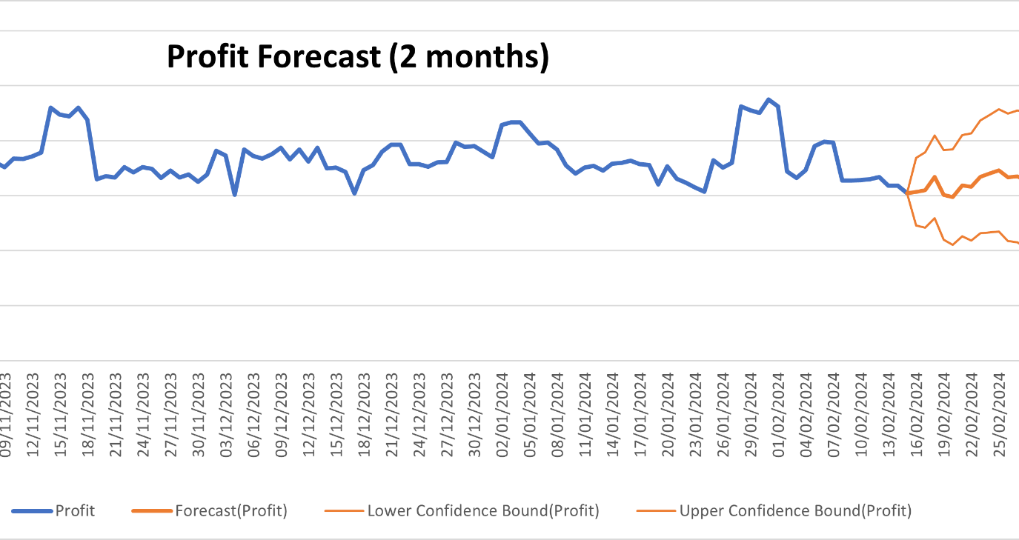
Notes:
Forecasting future profits using the available data was inconclusive due to limited months of complete data; more data is needed for accurate predictions.
Only 3 months had full data nov-jan
October starts on 7th
February goes up to 15th

Slide 16
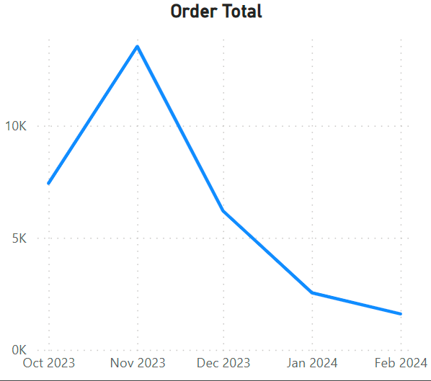
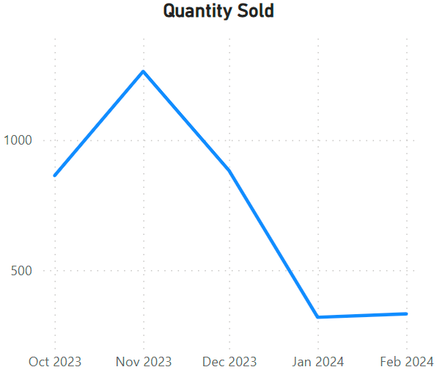
‘Fortune Cookie’ has shown a downwards trend in order total and quantity sold.
Least profitable
Consider discontinuation or re-evaluate marketing for product.

Slide 17
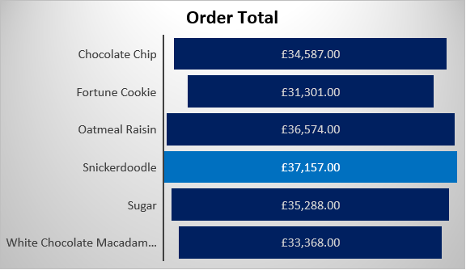
Snickerdoodle
Notes:
Made the most profit and had the highest order total
Which made them the best performing product

Slide 18
Total Profit & Average Order Total
Cookies | Sum of Profit
Chocolate Chip | £28,713.00
Fortune Cookie | £29,470.50
Oatmeal Raisin | £31,087.20
Snickerdoodle | £33,030.50
Sugar | £31,400.50
White Chocolate Macadamia Nut | £26,523.25
Grand Total | £180,224.95
Company | Average of Order Total
ABC Groceries | £1,773.22
ACME Bites | £1,730.50
Park & Shop Convenience Stores | £1,807.66
Tres Delicious | £1,147.90
Wholesome Foods | £1,190.78
Grand Total | £1,577.84

Slide 19
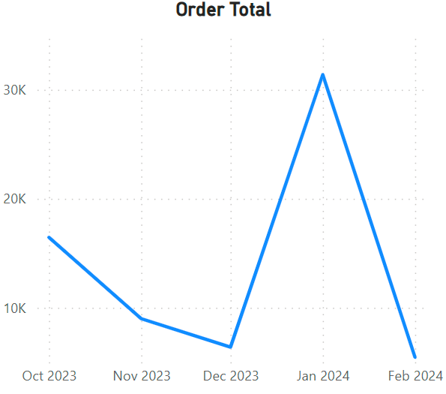
Park & Shop Convenience Stores
Notes:
Most valuable customer
Significant orders in January which made up for significantly lower orders in the previous months

Slide 20
Conclusion
Product Performance
Buyer Insights
Seasonal Trends
Company Spending
Forecasting
Notes:
Product Performance: Snickerdoodle emerged as the most profitable cookie, while fortune cookies lagged in orders and profitability.
Buyer Insights: Park & Shop Convenience Stores stood out with the highest average order total and quantity sold, indicating a strong partnership potential.
Seasonal Trends: Contrary to the hypothesis, there were no clear seasonal trends in cookie sales. January had the highest order total, while December had the least, suggesting other factors besides seasonality influencing sales.
Company Spending: ABC, ACME, and Park & Shop showed similar total spend patterns, with Tres Delicious having significantly lower spending.
Forecasting: as mentioned earlier Forecasting future profits using the available data was inconclusive due to limited months of complete data; more data is needed for accurate predictions.

Slide 21
Recommendations or Next Steps
Product Strategy
Partnership Focus
Data Collection
Market Expansion
Operational Efficiency
Notes:
Product Strategy: Consider discontinuing or reevaluating the production and marketing strategy for fortune cookies to improve profitability.
Partnership Focus: Strengthen the partnership with Park & Shop Convenience Stores due to their high average order total and quantity sold.
Data Collection: Continue collecting sales data to improve forecasting accuracy and identify long-term trends.
Market Expansion: Explore opportunities to increase sales with other high-potential buyers or by diversifying product offerings.
Operational Efficiency: Streamline processes based on buyer insights to optimize sales and production.

Slide 22

Questions

